Slide 1

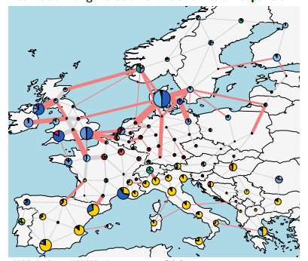
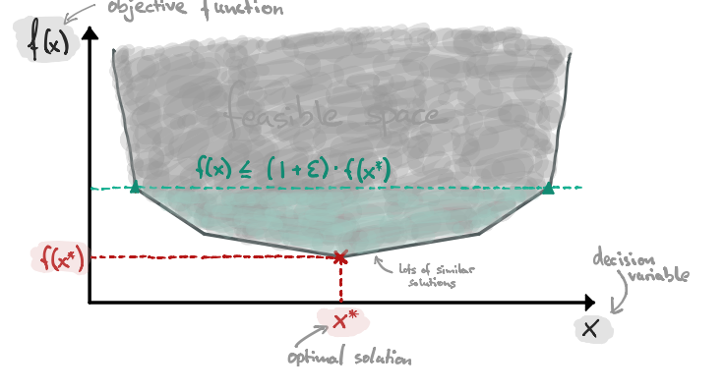
The central idea

Slide 2
Why is it interesting
We need to reduce CO2 emission
To facilitate this CO2 reduction, large structural change in the energy supply is needed
Modeling of energy systems is hard due to:
Parametric uncertainty
Structural uncertainty

Slide 3
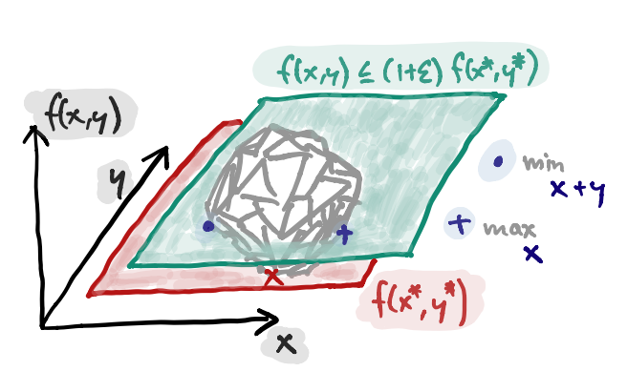
Main questions

Slide 4
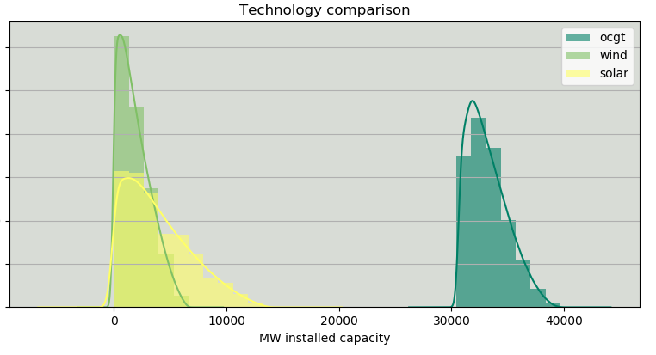
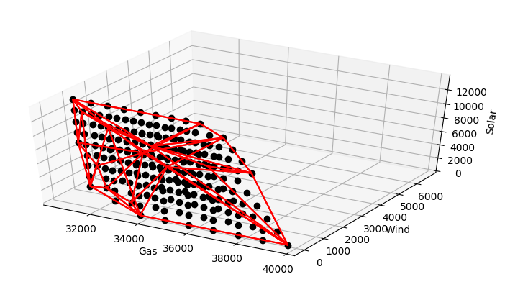
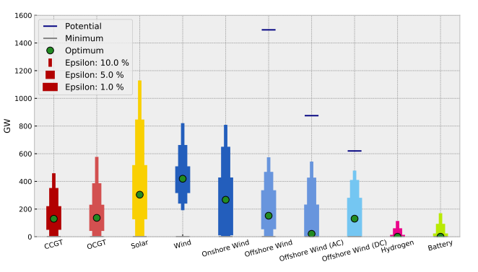
Expected results

